Slide 1
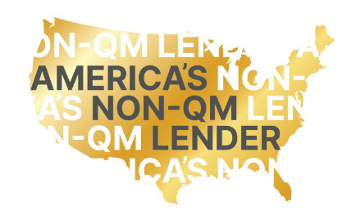

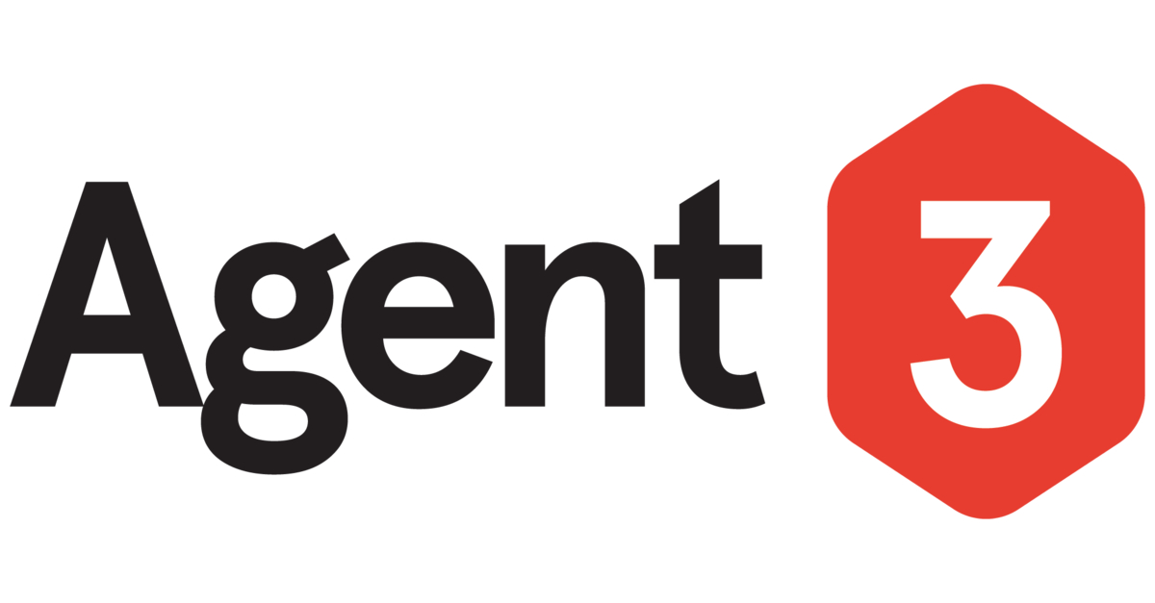
Final Recommendation Pitch | Agent3 | 12th Sept 2023

Slide 2
Background
Market Context
Post-pandemic, non-qualified mortgages (non-QM) are recovering their share of the USA market, with Government increasing their focus on developing affordable products for consumers.
It is expected mortgage brokers will play an increasingly important role in securing loans for US consumers.
Business Context
Change Wholesale (CW) has become the USA’s #1 non-QM lender, and is aiming to increase their financing of underbanked borrowers, through being on the panel for available mortgages across a broader broker audience.
Objective 1:
Secure new business with brokers who are registered on the CW portal but who are currently not trading
Objective 2:
Increase engagement with newly registered and prospective brokers
Objective 3:
Reach a broader audience and to encourage new broker signups
Q1.
Where CW spend its digital media budget and how can they more effectively use paid media to reach the 3 target group?
Q2.
Which campaign elements will help CW reach business objectives and what influence does location, size focus of brokers play?

Slide 3
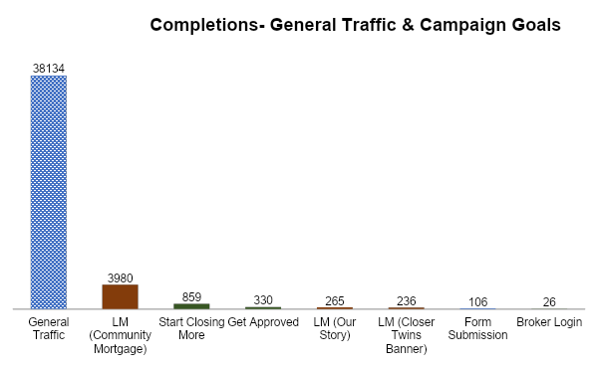
Topline Results: Goal Completion
13.3% of all completions
come from campaign audiences
Audience 1-6

Slide 4
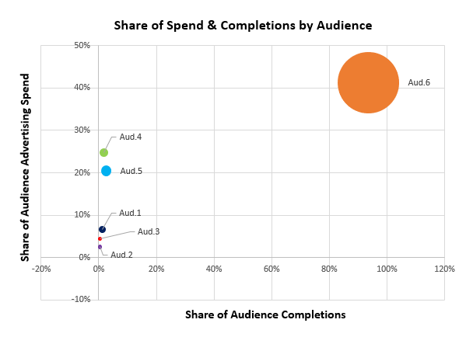
Topline Results: Audience Spend vs. Completions

Slide 5
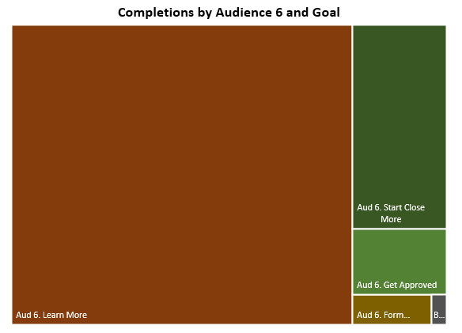
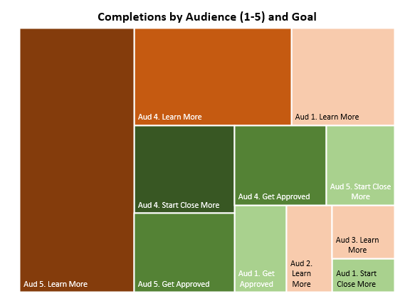
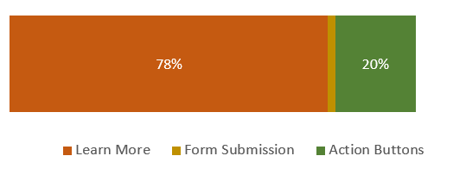
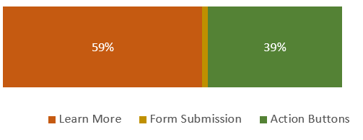
Topline Results: Audience by Goal Completion
5489
378

Slide 6
OBJECTIVE 1
Secure new business with brokers who are registered on the Change Wholesale portal but who are currently not trading with Change Wholesale

Slide 7
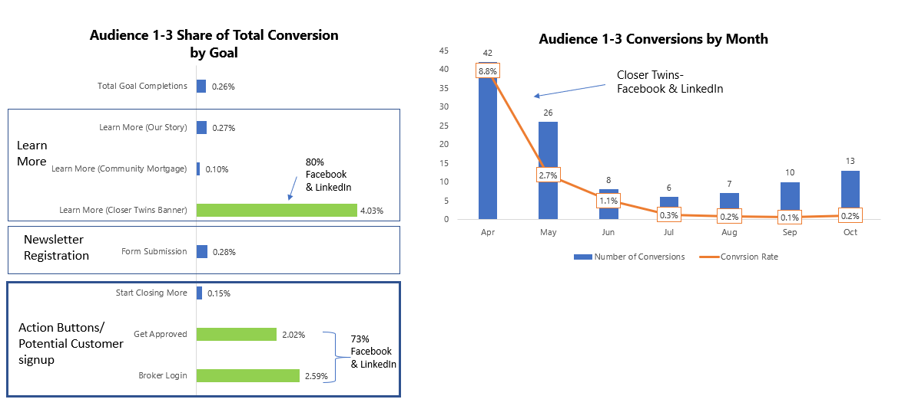
Audience 1-3 Share of Total Completions by Goal
Audience 1-3 Completions by Month
Number of Completions
Completion
Rate*
*Completion rate = Completions divided by Sessions as a percentage

Slide 8
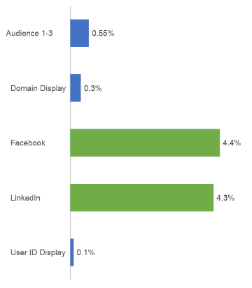
Audience 1-3 Mean Completion Rate by Platform
*Completion rate = Completions divided by Sessions as a percentage

Slide 9
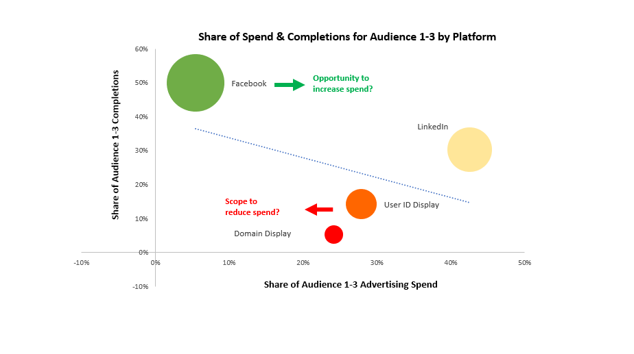
Opportunity to increase spend?
Scope to reduce spend?

Slide 10
OBJECTIVE 2
Increase engagement with newly registered and prospective brokers

Slide 11
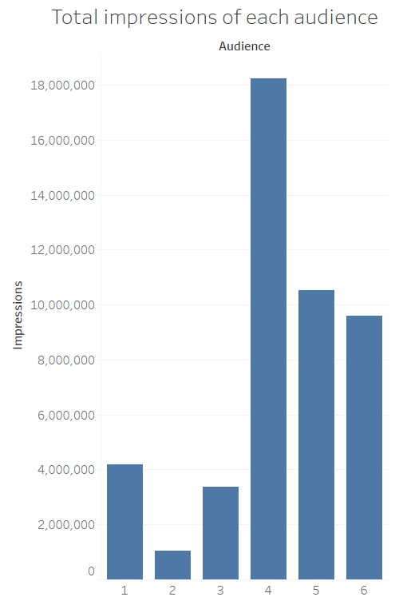
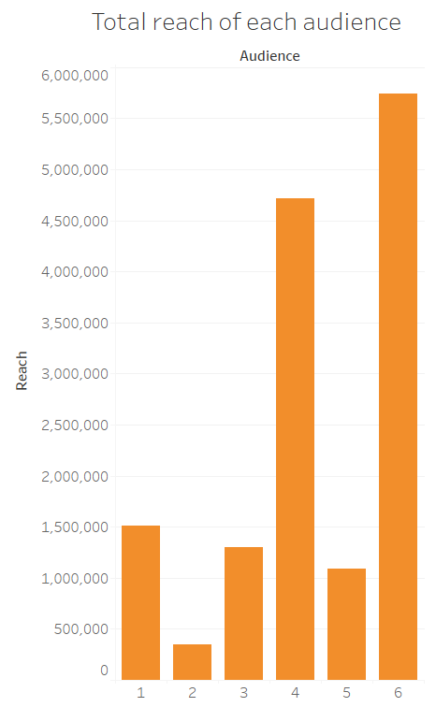

Slide 12
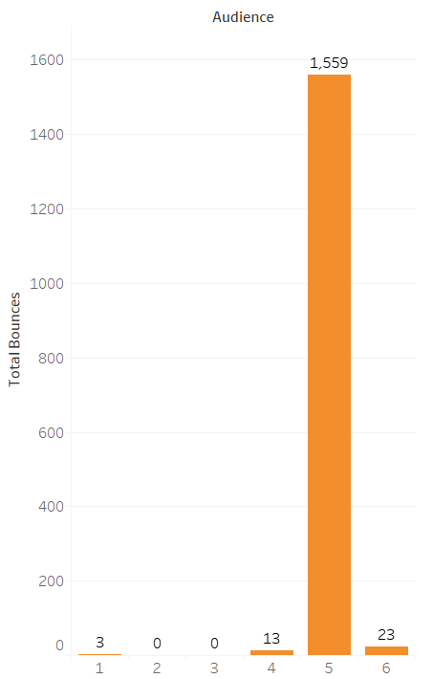
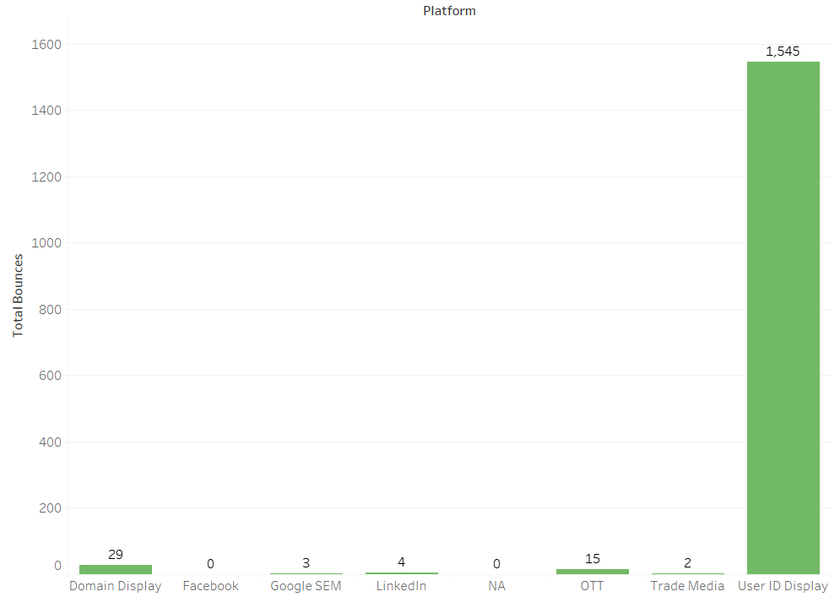

Slide 13
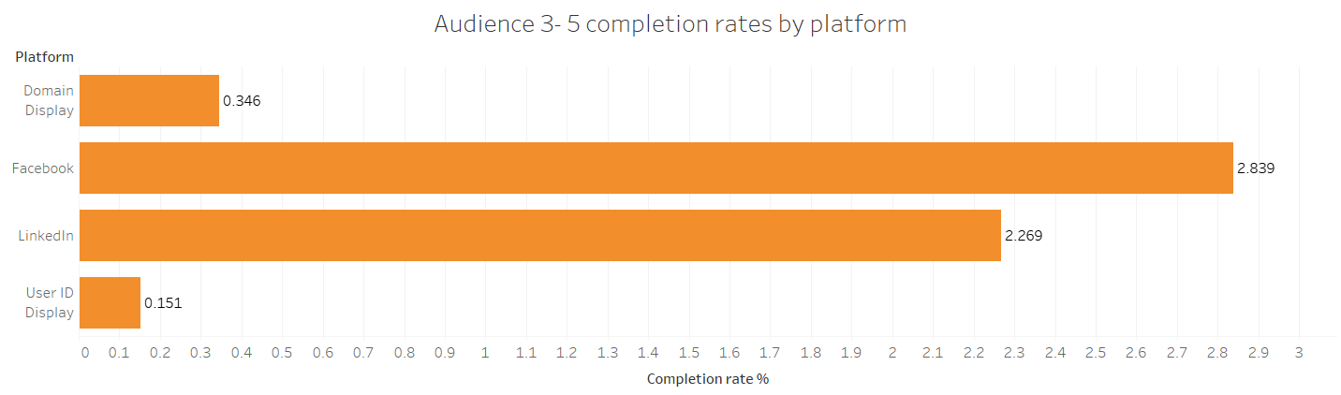
*Completion rate = Completions divided by Sessions as a percentage

Slide 14
OBJECTIVE 3
Reach a broader audience and to encourage new broker signups

Slide 15
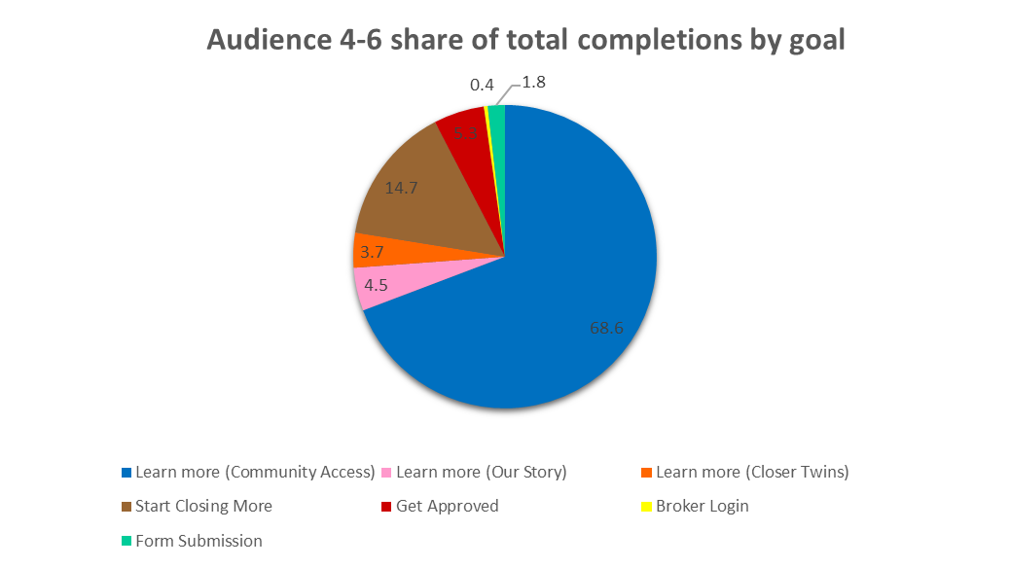

Slide 16
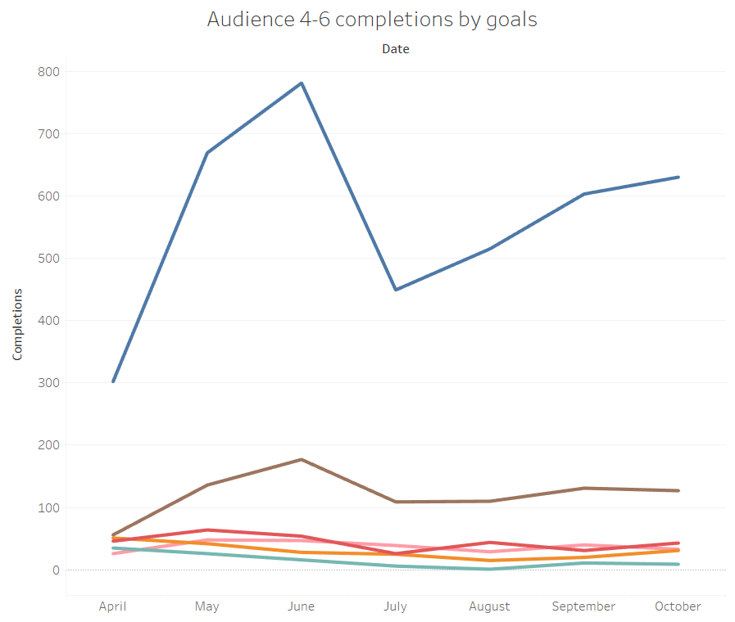
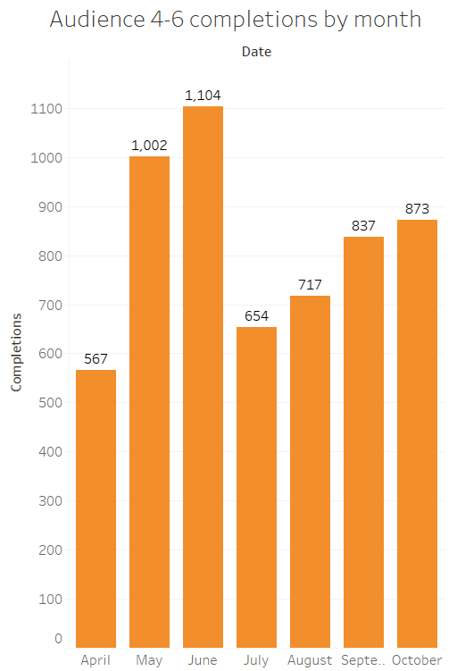
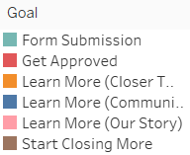

Slide 17
QUESTION 1
Predict where to spend the digital budget & how to use paid media to reach the three key target groups

Slide 18
Current strategy
Spend by audience group
$ 287,212
3
6 ($287K)
4
5
1
2
Reaches per completion (as a measure of ‘fitness’ of current campaign strategy)
3 (62K)
4
1
2
5
6
Spend by campaign (creative family)
$ 388,000
CF
CLOSER TWINS ($388K)
UNFAIR ADVANTAGE
SEM

Slide 19
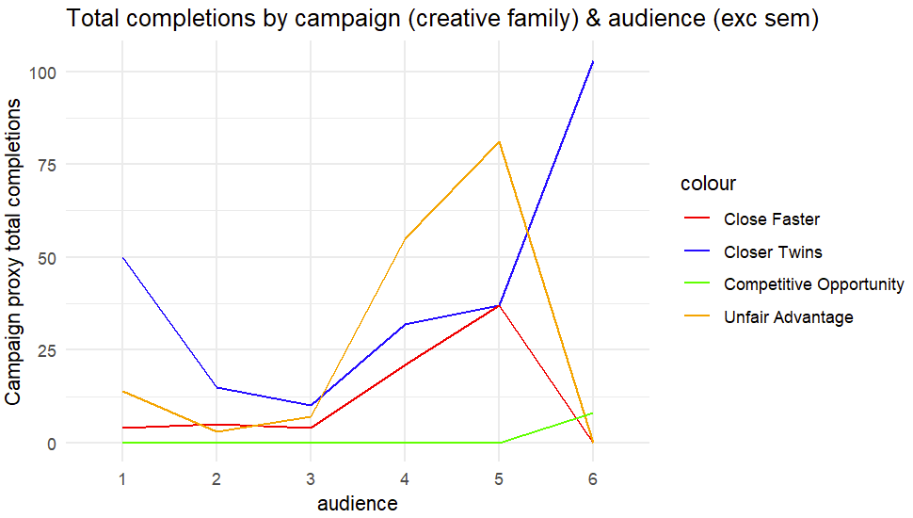
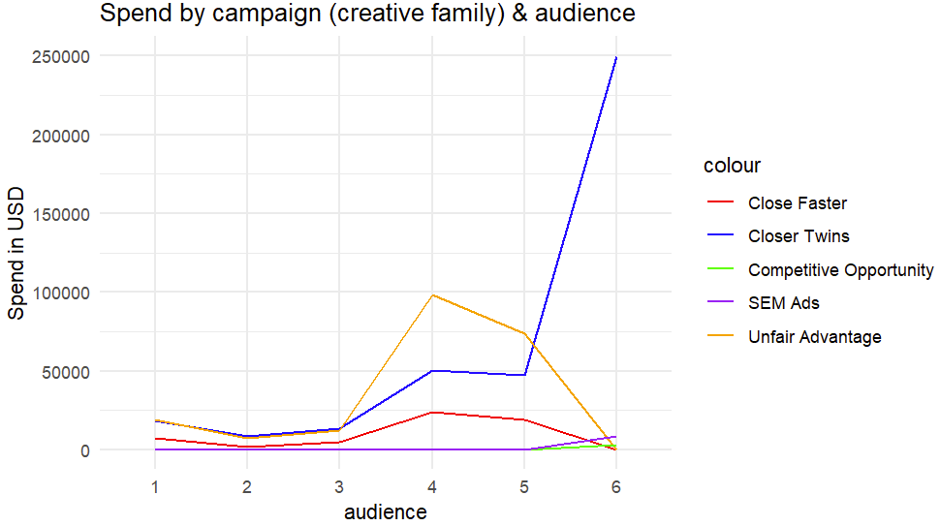
Current strategy
SEM produces 5,100 completions for audience 6 for less than $2 each
Cost of Closer Twins campaign for audience 6 is $249,833 and only produces ~100 completions
Cost of Competitive Opportunity campaign for audience 6 is $3,261
Audience 5 has completed better than audience 4 even though it was less funded

Slide 20
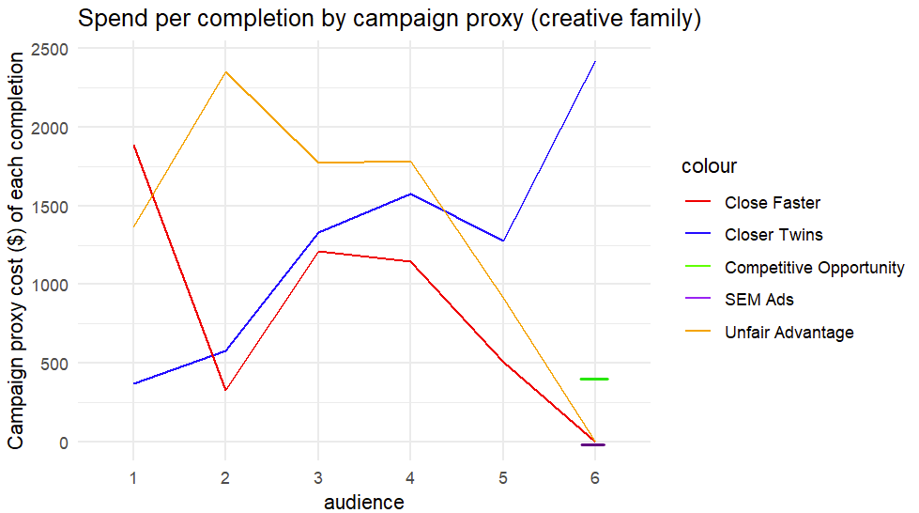
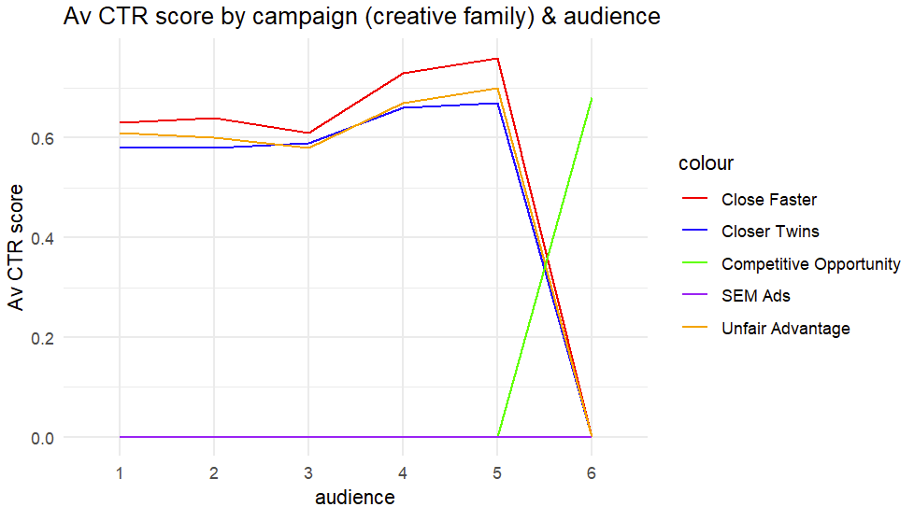
SEM costs less than $2 per completion
Competitive opportunity costs ~$400 per completion
Note: numerous missing values in CTR score

Slide 21
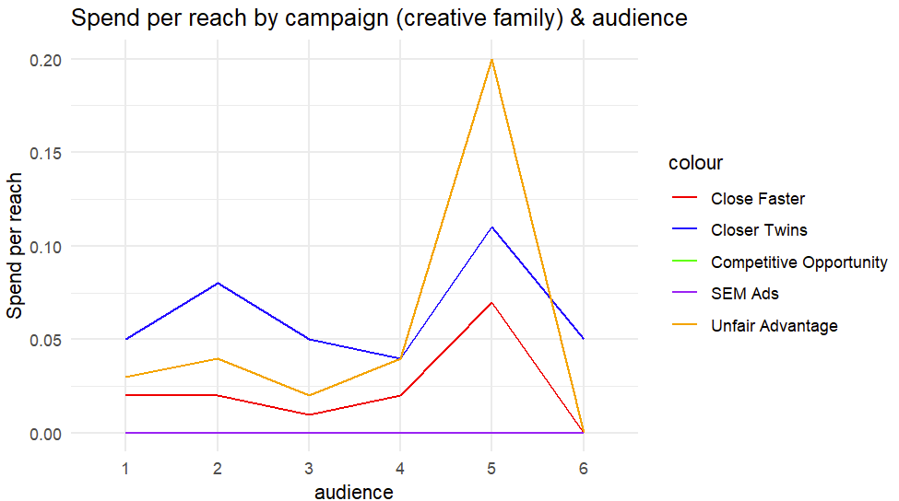
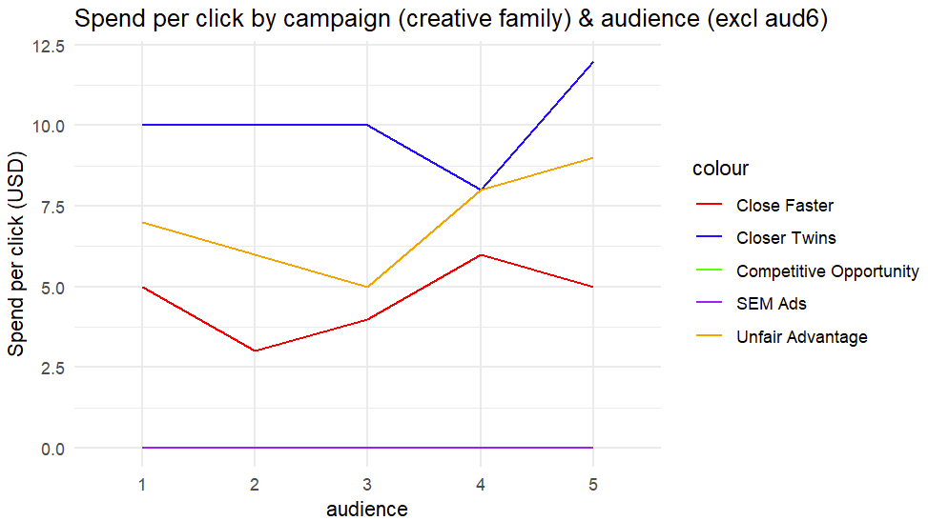
There is no reach information for SEM
Audience 6 is excluded because each click cost 3,500 through Closer Twins

Slide 22
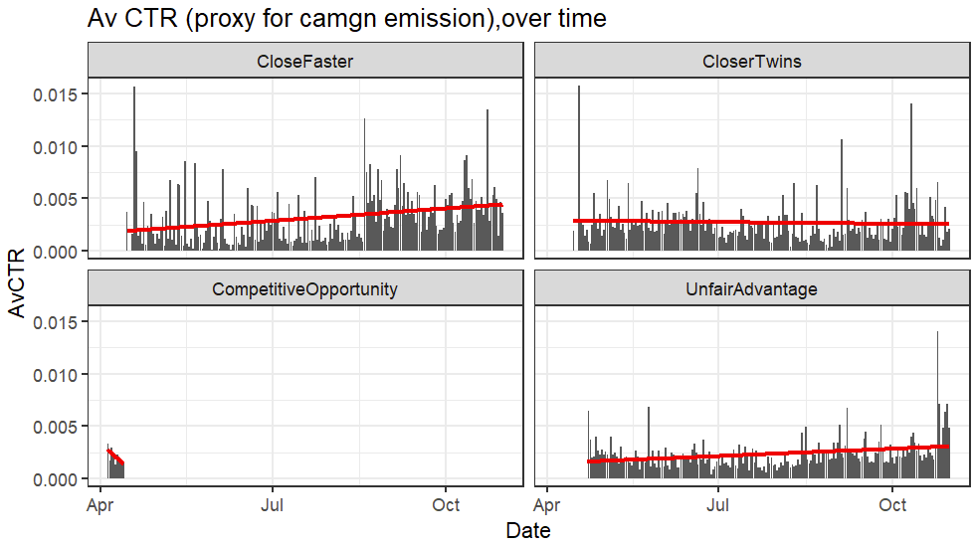
Campaigns not matched by funding
Close Faster trend for reach, impressions and av CTR increases over time unlike Closer Twins
Close Faster actually has a higher av CTR score than Closer Twins and Unfair Advantage even with current spend
*Please note there is no increasing trend in completions for any campaign over time

Slide 23
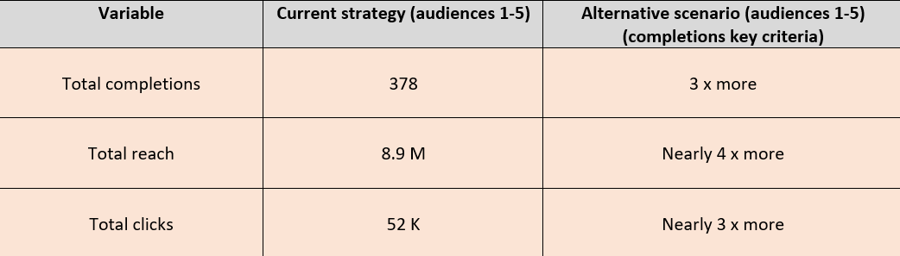
New possible strategy
$250K from Closer Twins spend (on audience 6) + $3.3K from Competitive Opportunity (on audience 6) plus existing spend on audiences 1 to 5, divided equally to audiences 1-5. All spend for audiences 2-5 spent on Close Faster campaign proxy (creative family). For audience 1 - funds were divided equally between Close Faster and Closer Twins.
* This assumes there is no business saturation point

Slide 24
QUESTION 2
What impact does size and focus of the brokers and location have?

Slide 25
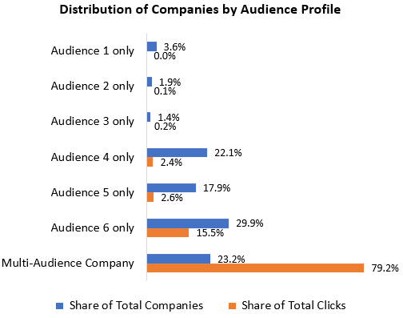
12,545 companies engaged with in campaign
50 companies
=
35% clicks
29% impressions
47% of companies deliver only 5.3% of completions

Slide 26
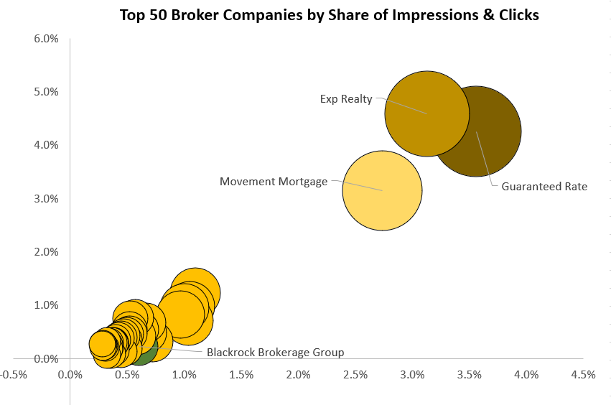
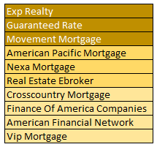
Top 10 Broker Opportunities
Share of total impressions
By increasing CTR for identified brokers to average of peers*, this can increase overall clicks of campaign by +7%
Share of total clicks
All top 50 companies, except Blackrock Brokerage Group, are multi-audience
*based upon top 200 brokers by clicks, removing CTR outliers
Comes to CTR of 0.21%

Slide 27
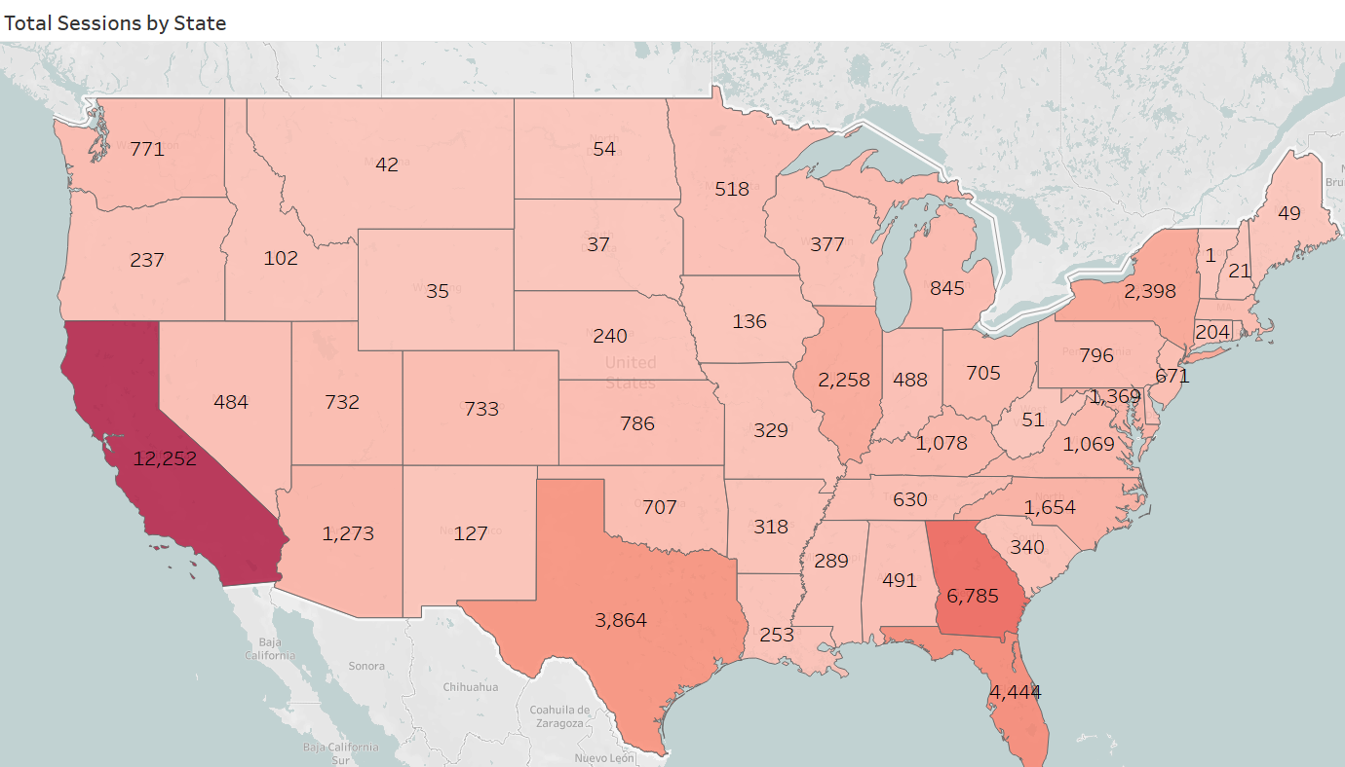
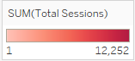
Top 5 Sessions per State
State | Total Sessions | Share of total sessions
California | 12,252 | 23.30%
Georgia | 6,785 | 12.90%
Florida | 4,444 | 8.40%
Texas | 3,864 | 7.30%
New York | 2,398 | 4.60%

Slide 28
USA States
1st priority to increase presence
12 States
6 States
Next group to assess reallocating of spend
High
Texas
New Jersey
South Carolina
Georgia
Maryland
Arizona
Mississippi
Missouri
Kentucky
Kansas
Connecticut
Hawaii
Relative Underbanked Population
27 States
6 States
Next group to increase presence
1st group to assess reallocating of spend
Pennsylvania
Ohio
Tennessee
California
DC
Illinois
Indiana
Missouri
Colorado
Virginia
Low
Utah
Low
High
Relative Campaign Presence
Notes:
Looking at CW website- three states do not have licence
Massachusetts
Missouri
New York

Slide 29
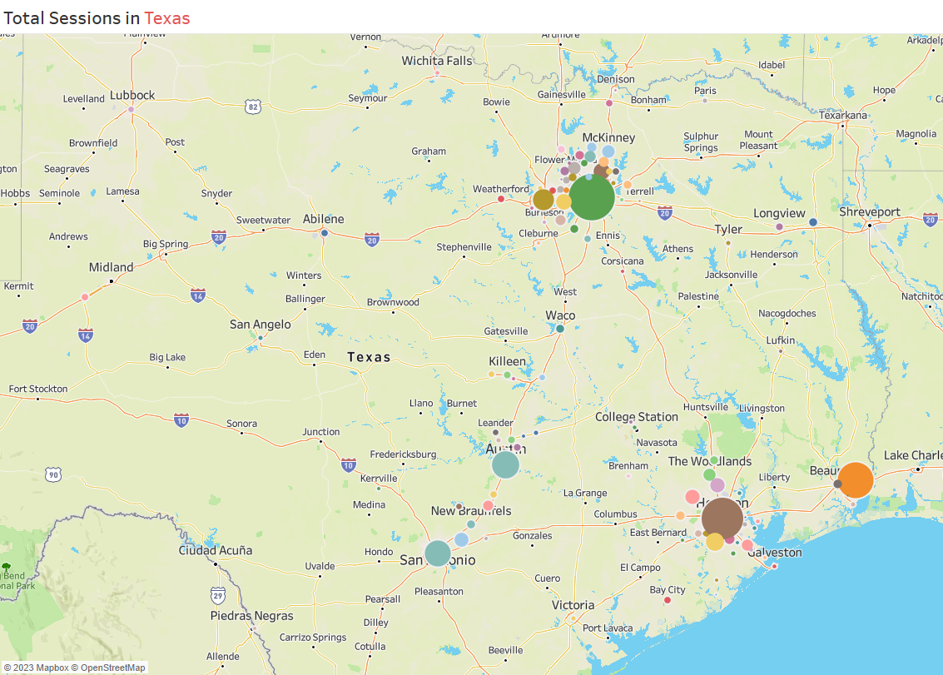
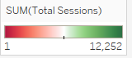
Top cities by sessions in Texas
 | Total Sessions | City Population | Share of total sessions
Dallas | 610 | 1,300,092 | 15.79%
Houston | 495 | 2,304,580 | 12.81%
Orange | 368 | 19,347 | 9.52%
Austin | 212 | 931,830 | 5.49%
San Antonio | 194 | 1,434,625 | 5.02%

Slide 30
INSIGHTS & RECOMMENDATIONS

Slide 31
Audience 6 is best targeted using Sem Ads Campaign
Redistribute the Close Faster and Competitive Opportunity funds spent on audience 6 (not required and expensive) to audiences 1-5 who have a lower response to campaigns
Use Close Faster for audiences 1- 5, which has an overall lower cost per completion, lowest cost per reach and lowest cost per click.
Close Faster trends towards an increase in reach and impressions over time, unlike Closer Twins.
Increase advertising spend on facebook (from User ID display) to secure new business with brokers who are already registered (audiences 1-3)
Spend redistribution

Slide 32
Prioritise states with a higher than expected proportion of underbanked households, but with a low level of campaign presence - specifically where Change Wholesale do not have a licence
Change Wholesale increasing their focus on these states, has the potential to raise interest with brokers who serve a larger underbanked community
Improve engagement with underbanked population
Use paid media more effectively to increase CTR for an identified group of ten broker companies to the average rate of their industry peers
This could increase overall clicks from the campaign by +7%
Enhance company media distribution

Slide 33
Thank You

Slide 34
APPENDIX

Slide 35
OBJECTIVES 1-3

Slide 37
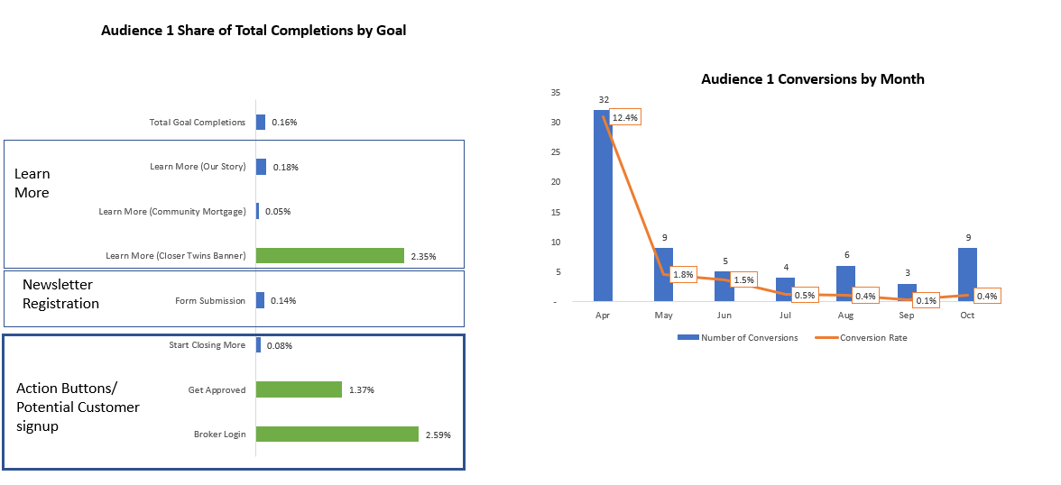
Objective 1: Secure new business with brokers who are registered on the Change Wholesale portal but who are currently not trading with Change

Slide 38
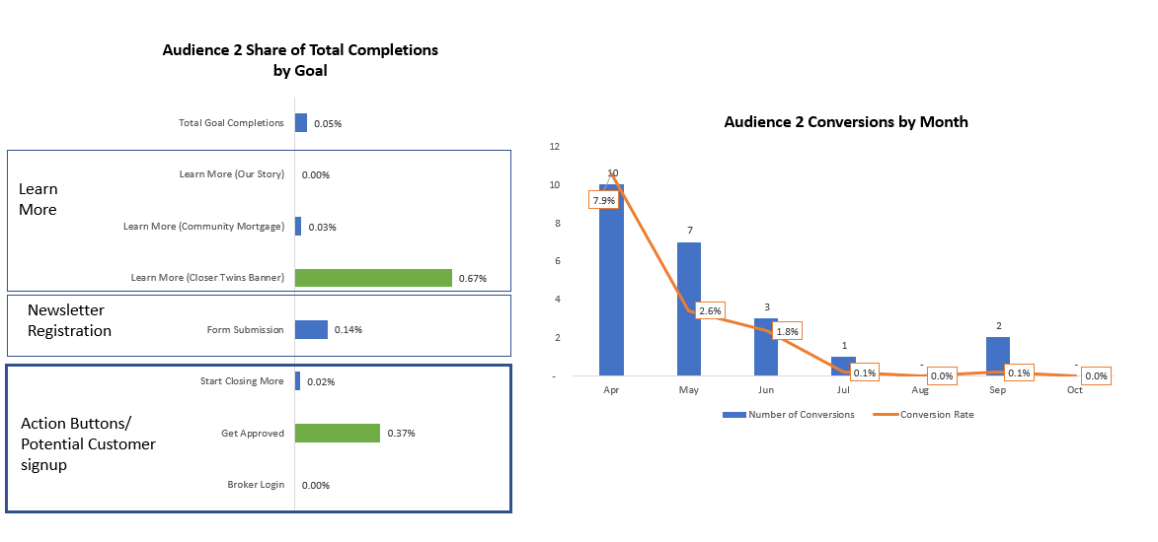
Objective 1: Secure new business with brokers who are registered on the Change Wholesale portal but who are currently not trading with Change

Slide 39
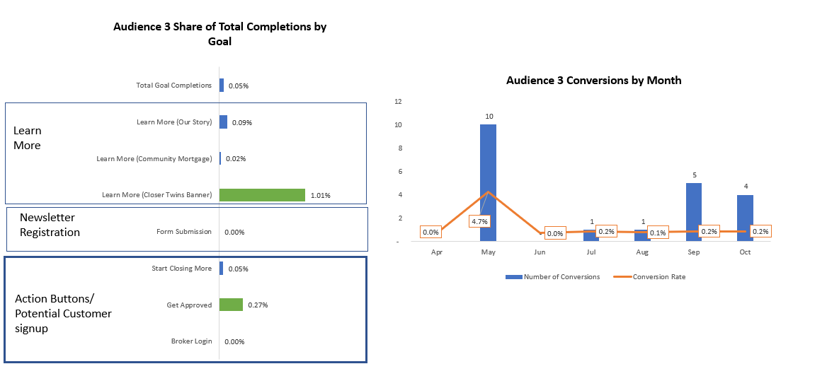
Objective 1: Secure new business with brokers who are registered on the Change Wholesale portal but who are currently not trading with Change

Slide 40
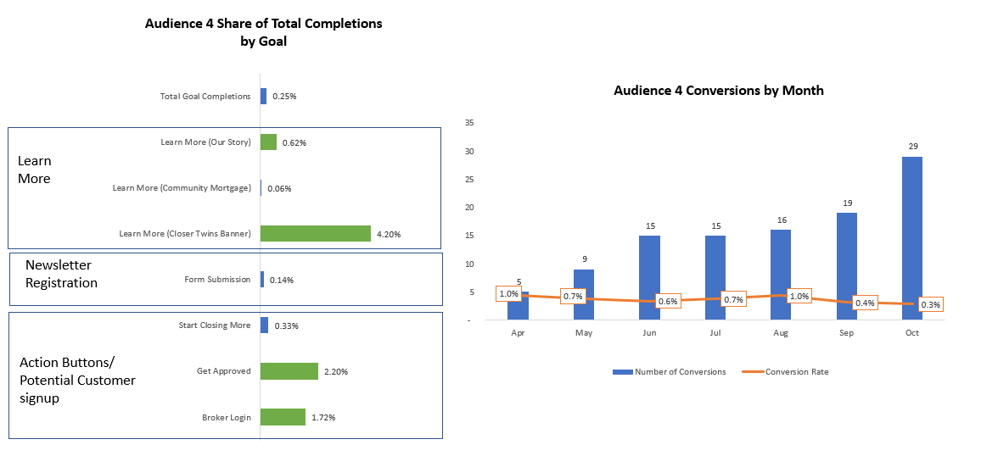
Audience 4- By Goal

Slide 41
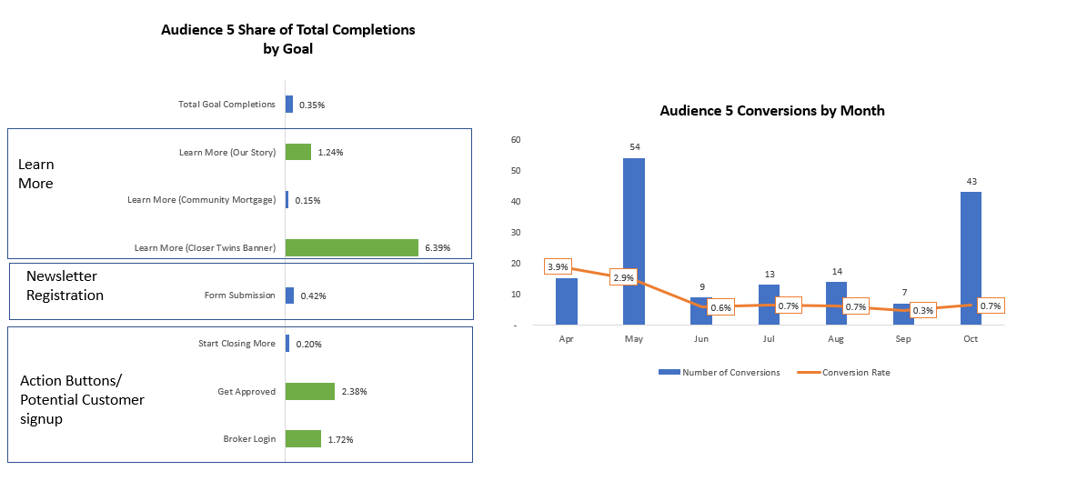
Audience 5- By Goal

Slide 42
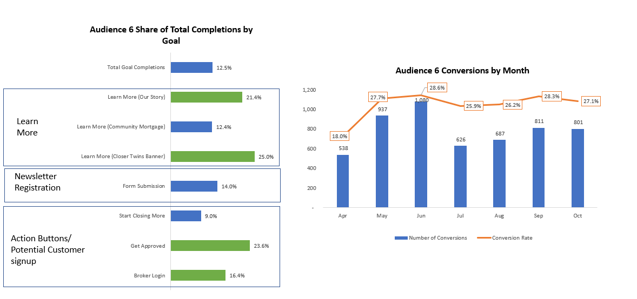
Audience 6- By Goal

Slide 43
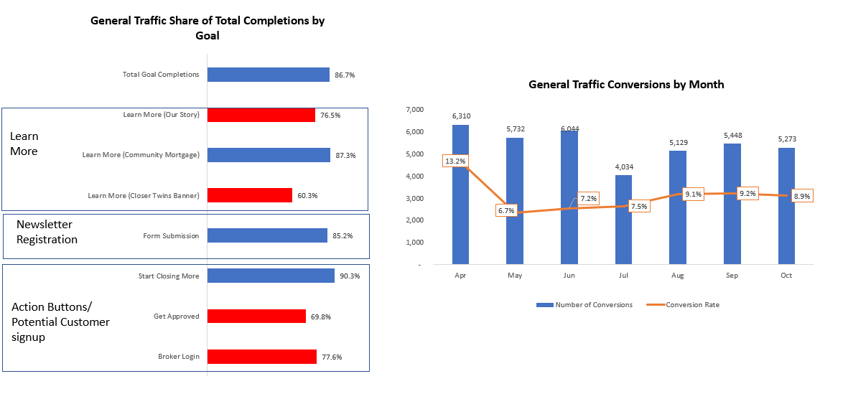
General Traffic- By Goal

Slide 44
All Audiences -By Platform

Slide 45
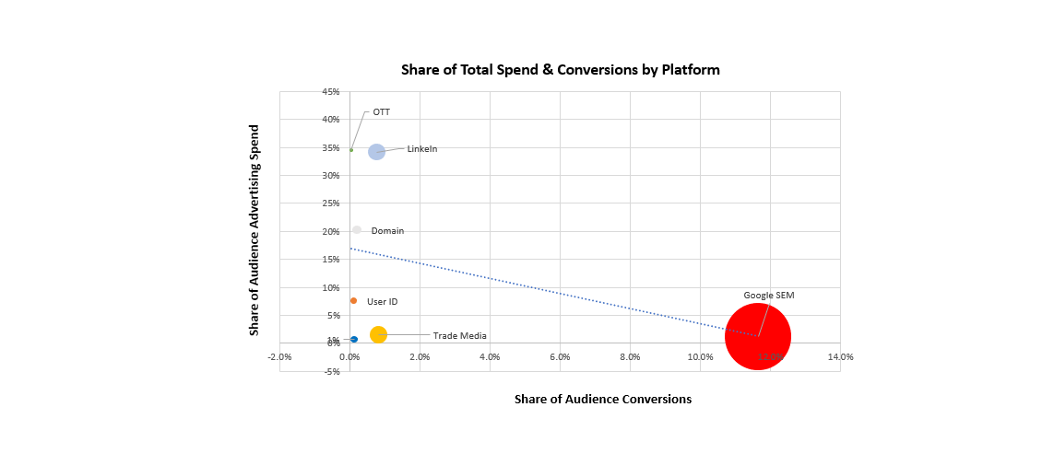
All Audiences - By Platform

Slide 46
Objective 1: Secure new business with brokers who are registered on the Change Wholesale portal but who are currently not trading with Change

Slide 47
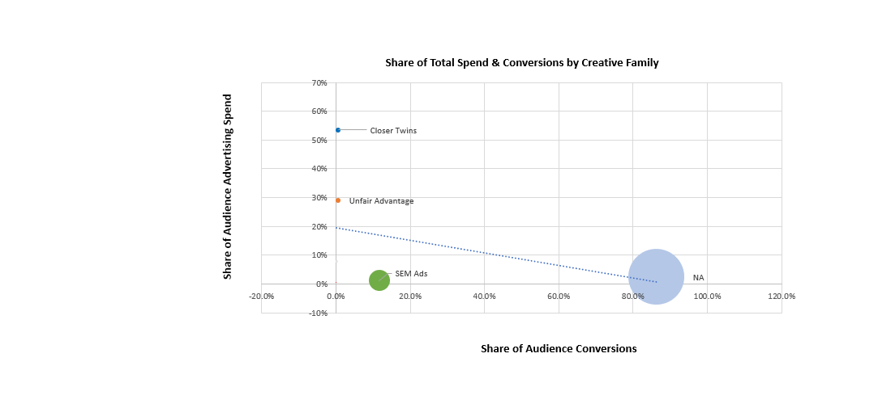
All Audiences - By Creative Family

Slide 48
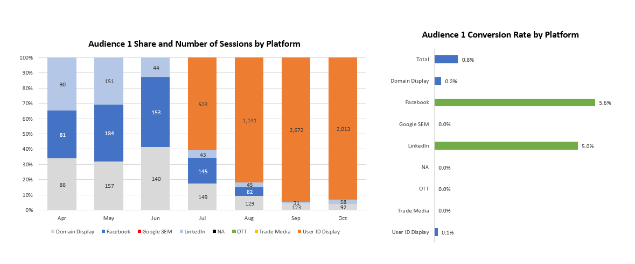
Objective 1: Secure new business with brokers who are registered on the Change Wholesale portal but who are currently not trading with Change

Slide 49
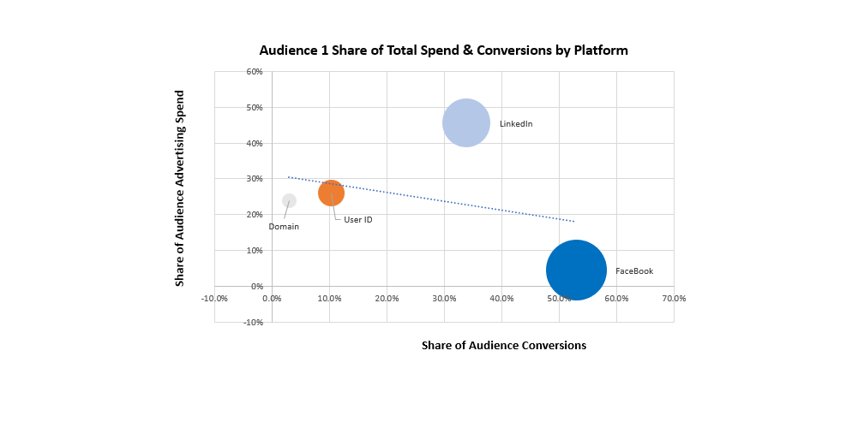
Objective 1: Secure new business with brokers who are registered on the Change Wholesale portal but who are currently not trading with Change

Slide 50
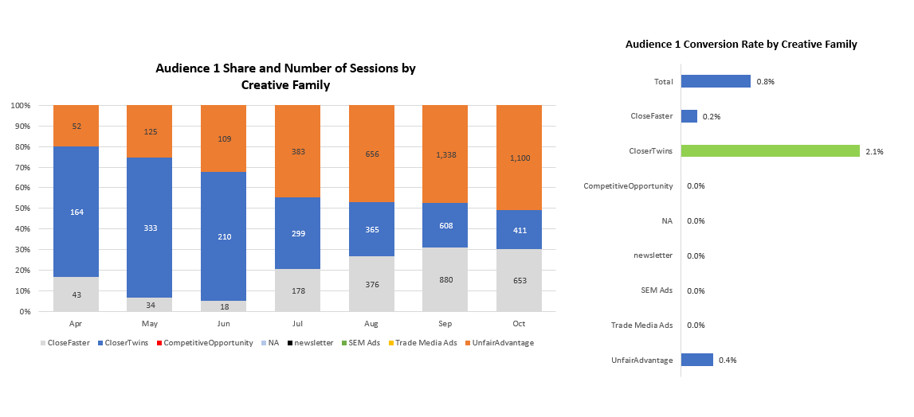
Objective 1: Secure new business with brokers who are registered on the Change Wholesale portal but who are currently not trading with Change

Slide 51
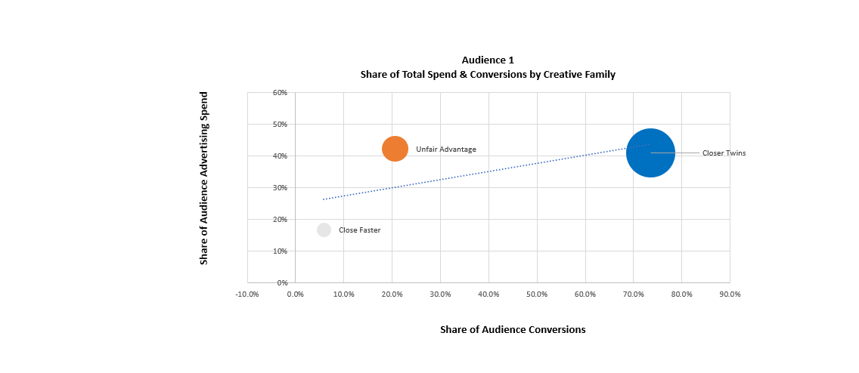
Objective 1: Secure new business with brokers who are registered on the Change Wholesale portal but who are currently not trading with Change

Slide 52
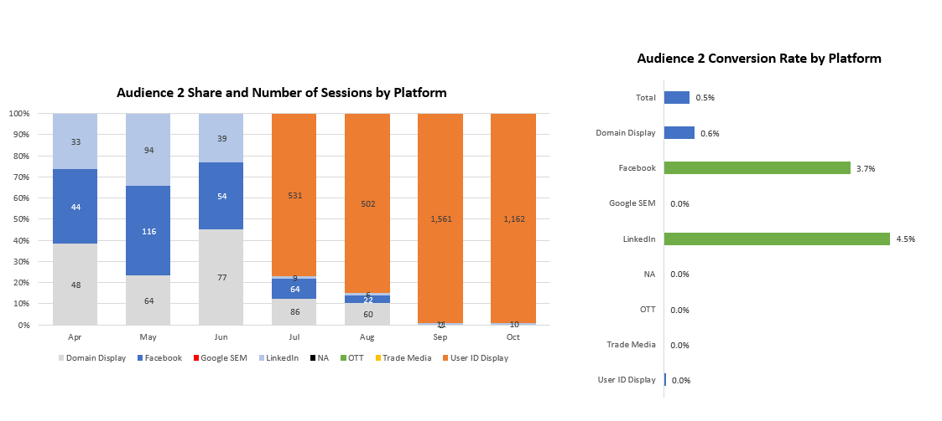
Objective 1: Secure new business with brokers who are registered on the Change Wholesale portal but who are currently not trading with Change

Slide 53
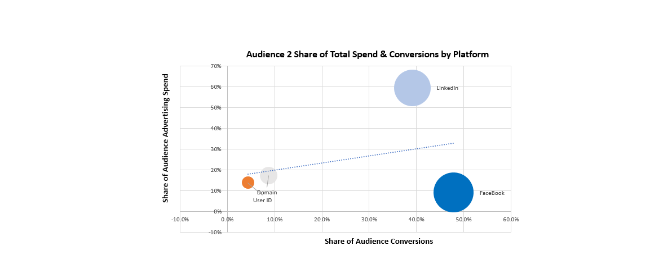
Objective 1: Secure new business with brokers who are registered on the Change Wholesale portal but who are currently not trading with Change

Slide 54

Objective 1: Secure new business with brokers who are registered on the Change Wholesale portal but who are currently not trading with Change

Slide 55

Objective 1: Secure new business with brokers who are registered on the Change Wholesale portal but who are currently not trading with Change

Slide 56

Objective 1: Secure new business with brokers who are registered on the Change Wholesale portal but who are currently not trading with Change

Slide 57

Objective 1: Secure new business with brokers who are registered on the Change Wholesale portal but who are currently not trading with Change

Slide 58

Objective 1: Secure new business with brokers who are registered on the Change Wholesale portal but who are currently not trading with Change

Slide 59

Objective 1: Secure new business with brokers who are registered on the Change Wholesale portal but who are currently not trading with Change

Slide 60

Audience 4- By Platform

Slide 61

Audience 4- By Platform

Slide 62

Audience 4- By Creative Family

Slide 63

Audience 4- by Creative Family

Slide 64

Audience 5- by Platform

Slide 65

Audience 5- by Platform

Slide 66

Audience 5- by Creative Family

Slide 67

Audience 5- by Creative Family

Slide 68

Objective 1: Secure new business with brokers who are registered on the Change Wholesale portal but who are currently not trading with Change

Slide 69

Audience 6 - By Platform

Slide 70

Audience 6 by Creative Family

Slide 71

Audience 6 by Creative Family

Slide 72

General Traffic by Platform

Slide 73



Slide 74


Slide 75

Objective 3: Reach a broader audience and to encourage new broker signups.
Notes:
To reach a broader audience and to encourage new broker signups audiences 4 -6 have been analysed.
Audience 6 (5.7mil) & audience 4 (4.7mil) reach the most individuals so far. Audience 5 reaches less than both audiences 1 & 2 with only 1.1million individuals reached. This would be an area to look to improve. Audiences 4 - 6 make up for 24.98% of the total goal completions, most of these completions were by audience 6 with 23.39% of the goal completions (5489). Increasing goal completions of audience 4 & 5 would help the objective.

Slide 76


Objective 3: Reach a broader audience and to encourage new broker signups.
Notes:
To reach a broader audience and to encourage new broker signups audiences 4 -6 have been analysed.
Audience 6 (5.7mil) & audience 4 (4.7mil) reach the most individuals so far. Audience 5 reaches less than both audiences 1 & 2 with only 1.1million individuals reached. This would be an area to look to improve. Audiences 4 - 6 make up for 24.98% of the total goal completions, most of these completions were by audience 6 with 23.39% of the goal completions (5489). Increasing goal completions of audience 4 & 5 would help the objective.

Slide 77


Objective 3: Reach a broader audience and to encourage new broker signups.
Notes:
To reach a broader audience and to encourage new broker signups audiences 4 -6 have been analysed.
Audience 6 (5.7mil) & audience 4 (4.7mil) reach the most individuals so far. Audience 5 reaches less than both audiences 1 & 2 with only 1.1million individuals reached. This would be an area to look to improve. Audiences 4 - 6 make up for 24.98% of the total goal completions, most of these completions were by audience 6 with 23.39% of the goal completions (5489). Increasing goal completions of audience 4 & 5 would help the objective.

Slide 78

Objective 3: Reach a broader audience and to encourage new broker signups.
Notes:
To reach a broader audience and to encourage new broker signups audiences 4 -6 have been analysed.
Audience 6 (5.7mil) & audience 4 (4.7mil) reach the most individuals so far. Audience 5 reaches less than both audiences 1 & 2 with only 1.1million individuals reached. This would be an area to look to improve. Audiences 4 - 6 make up for 24.98% of the total goal completions, most of these completions were by audience 6 with 23.39% of the goal completions (5489). Increasing goal completions of audience 4 & 5 would help the objective.

Slide 79


Objective 3: Reach a broader audience and to encourage new broker signups.
Notes:
To reach a broader audience and to encourage new broker signups audiences 4 -6 have been analysed.
Audience 6 (5.7mil) & audience 4 (4.7mil) reach the most individuals so far. Audience 5 reaches less than both audiences 1 & 2 with only 1.1million individuals reached. This would be an area to look to improve. Audiences 4 - 6 make up for 24.98% of the total goal completions, most of these completions were by audience 6 with 23.39% of the goal completions (5489). Increasing goal completions of audience 4 & 5 would help the objective.

Slide 80


Objective 3: Reach a broader audience and to encourage new broker signups.
Notes:
To reach a broader audience and to encourage new broker signups audiences 4 -6 have been analysed.
Audience 6 (5.7mil) & audience 4 (4.7mil) reach the most individuals so far. Audience 5 reaches less than both audiences 1 & 2 with only 1.1million individuals reached. This would be an area to look to improve. Audiences 4 - 6 make up for 24.98% of the total goal completions, most of these completions were by audience 6 with 23.39% of the goal completions (5489). Increasing goal completions of audience 4 & 5 would help the objective.

Slide 81


Objective 3: Reach a broader audience and to encourage new broker signups.
Notes:
To reach a broader audience and to encourage new broker signups audiences 4 -6 have been analysed.
Audience 6 (5.7mil) & audience 4 (4.7mil) reach the most individuals so far. Audience 5 reaches less than both audiences 1 & 2 with only 1.1million individuals reached. This would be an area to look to improve. Audiences 4 - 6 make up for 24.98% of the total goal completions, most of these completions were by audience 6 with 23.39% of the goal completions (5489). Increasing goal completions of audience 4 & 5 would help the objective.

Slide 82


Objective 3: Reach a broader audience and to encourage new broker signups.
Notes:
To reach a broader audience and to encourage new broker signups audiences 4 -6 have been analysed.
Audience 6 (5.7mil) & audience 4 (4.7mil) reach the most individuals so far. Audience 5 reaches less than both audiences 1 & 2 with only 1.1million individuals reached. This would be an area to look to improve. Audiences 4 - 6 make up for 24.98% of the total goal completions, most of these completions were by audience 6 with 23.39% of the goal completions (5489). Increasing goal completions of audience 4 & 5 would help the objective.

Slide 83


Objective 3: Reach a broader audience and to encourage new broker signups.
Notes:
To reach a broader audience and to encourage new broker signups audiences 4 -6 have been analysed.
Audience 6 (5.7mil) & audience 4 (4.7mil) reach the most individuals so far. Audience 5 reaches less than both audiences 1 & 2 with only 1.1million individuals reached. This would be an area to look to improve. Audiences 4 - 6 make up for 24.98% of the total goal completions, most of these completions were by audience 6 with 23.39% of the goal completions (5489). Increasing goal completions of audience 4 & 5 would help the objective.

Slide 84
QUESTION 1
Predict where to spend the digital budget & how to use paid media to reach the three key target groups

Slide 85

Linear modelling summary
However, the data is not normally distributed.

Slide 86
Question 1
Spend by campaign proxy
These are multiples of the smallest spend (Competitive Opportunity)
Unfair Advantage (x70)
Closer Twins (x129)
Cl Faster (x19)
CO (x1)
SEM (x3)
Spend by audience
These are multiples of the smallest spend (audience 2)
Aud 6
(x 17)
Aud 1
(x 3)
Aud 4
(x 10)
Aud 5
(x 8)
A2 (x1)
A 3
(x 2)

Slide 87
Question 1
Spend by platform
These are multiples of the smallest spend (audience 2)
User ID Display
(x 55)
LinkedIn
(x 248)
Insta (x1)
SEM
(x 8)
Domain Display
(x 147)
Trade Media
(x 11)
FB
(x 5)

Slide 88

Question 1:

Slide 89

Question 1:

Slide 90

Question 1:

Slide 91

Question 1:

Slide 92


Question 1:

Slide 93

Question 1:

Slide 94


Question 1:

Slide 95

Question 1:

Slide 96

Question 1:

Slide 97
Not matched by funding
Closer Twins better for completions for audiences 1-3 but consider value for brand and industry awareness of reach
Close Faster and Unfair Advantage can’t match the max reach of Closer Twins but they do continue to increase over time

Slide 98

Not matched by funding
Closer Twins better for completions for audiences 1-3 but consider value for brand and industry awareness of increasing impressions
Close Faster and Unfair advantage continue to increase their impressions over time unlike Closer Twins and Unfair Advantage grows to match Closer Twins at its highest
Unfair Advantage had less spend for its campaign and resulted in more impressions over time

Slide 99
QUESTION 2
What impact does size and focus of the brokers and location have?

Slide 100


Slide 101

Top cities by sessions in Pennsylvania
 | Total Sessions | City Population | Share of total sessions
Philadelphia | 347 | 1,576,251 | 43.59%
Pittsburgh | 84 | 304,391 | 10.55%
Montgomeryville | 51 | 12,988 | 6.41%
York | 28 | 43,992 | 3.52%

Slide 102

Questions 2C: What influence does location and size play?
Top 5 Sessions per State
State | Total Sessions | Share of total sessions
California | 12252 | 23.30%
Georgia | 6785 | 12.90%
Florida | 4444 | 8.40%
Texas | 3864 | 0.073
New York | 2398 | 0.046
Mississippi | 5672 | 0.059

Slide 103


Question 2c: What influence does location and size(population) play?

Slide 104
Question 2: Which campaign elements will help CW reach business objectives and what influence does location, size focus of brokers play?
12 States
6 States
High
State | Underbanked Population Rank | Campaign Sessions Rank
Florida | 3 | 3
Texas | 1 | 4
Oklahoma | 18 | 18
New Jersey | 9 | 21
Nevada | 28 | 26
South Carolina | 17 | 28
Arkansas | 30 | 31
Mississippi | 25 | 33
Louisiana | 15 | 34
Delaware | 40 | 37
Connecticut | 26 | 38
New Mexico | 34 | 40
State | Underbanked Population Rank | Campaign Sessions Rank
Georgia | 5 | 2
Maryland | 16 | 8
Arizona | 12 | 9
Kentucky | 21 | 10
Kansas | 32 | 14
Hawaii | 41 | 30
27 States
6 States
Relative Underbanked Population
State | Underbanked Population Rank | Campaign Sessions Rank
New York | 4 | 5
Pennsylvania | 6 | 13
Ohio | 7 | 20
North Carolina | 8 | 7
Michigan | 10 | 12
Washington | 13 | 15
Tennessee | 14 | 22
Indiana | 19 | 25
Missouri | 20 | 29
Massachusetts | 22 | 19
State | Underbanked Population Rank | Campaign Sessions Rank
California | 2 | 1
Washington DC | 47 | 32
Illinois | 11 | 6
Colorado | 27 | 16
Virginia | 24 | 11
Utah | 36 | 17
Low
Low
High
Relative Campaign Presence
Notes:
New york

Slide 105
Top insights and recommendations:
Spend redistribution
Audience 6 is best targeted using Sem Ads Campaign
Redistribute the Close Faster and Competitive Opportunity funds spent on audience 6 (not required and expensive) to audiences 1-5 who have a lower response to campaigns
As a better option, use Close Faster for audiences 1- 5, which has an overall lower cost per completion, lowest cost per reach, lowest cost per click, the best average CTR score across the three main campaigns and trends towards an increase in reach and impressions over time
Increase advertising spend on facebook (from User ID display) to secure new business with brokers who are already registered (audiences 1-3)
Improved engagement with underbanked population
Prioritise states with a higher than expected proportion of underbanked households, but with a low level of campaign presence - specifically where Change Wholesale do not have a licence
Change Wholesale increasing their focus on these states, has the potential to raise interest with brokers who serve a larger underbanked community
Enhanced company media distribution
Use paid media more effectively to increase CTR for an identified group of ten broker companies to the average rate of their industry peers, this would increase overall clicks from the campaign by +7%. This reinforces the benefit of running a targeted campaign effectively, as opposed to a general campaign ineffectively

Slide 106
Top insights and recommendations:
Audience 6 is best Targeted using Sem Ads Campaign
Redistribute the Close Faster and Competitive Opportunity funds spent on audience 6 (not required and expensive) to audiences 1-5 who have a lower response to campaigns
Use Close Faster for audiences 1- 5, which has an overall lower cost per completion, lowest cost per reach, lowest cost per click, the best average CTR score across the three main campaigns and trends towards an increase in reach and impressions over time
USA States with a higher than expected proportion of underbanked households, but with a low level of campaign presence. Change Wholesale increasing their focus on these states, has the potential to raise interest with brokers who serve a larger underbanked community.
By more effectively using paid media to increase CTR for an identified group of ten broker companies to the average rate of their industry peers, this would increase overall clicks from the campaign by +7%. Highlighting the benefit of running a targeted campaign effectively, as opposed to a general campaign ineffectively
Increase advertising spend on facebook (from User ID display) to secure new business with brokers who are already registered (audiences 1-3)
Increase advertising of Learn more (community access) goal.

Slide 107
Question 1:
Predict where to spend the digital budget & how to use paid media to reach the three key target groups
Identify ‘bad’ spend -
(Closer Twins funds for audience 6 - Google SEM offers the most completions for the lowest cost and the ~$250K spent here could be redistributed to audience groups which are ‘engaged’ but ‘completing’ less)
Competitive Opportunity was directed at Audience 6 but costs ~$400 per completion and the ~$3,200 might be better spent elsewhere
Identify ‘could do better’ campaign strategies for particular audiences - audiences 3, 4, 1, 2 require many more reaches per completion (as an indication of campaign ‘fit’) than audiences 5 and 6
Redirect funds and review campaigns to optimise completions for audiences 1-5. The originally ‘more engaged’ audiences 1-3 have now fallen behind audiences 5-6 in terms of completions. See use of Close Faster.
Non monetary features that may help branding and industry awareness: audiences 1-3 ‘complete’ well with the Closer Twins campaign. However, Close Faster and Unfair Advantage offer benefits that Closer Twins doesn’t.
There may be an added advantage in varying advertising campaign by audience

Slide 108
Actionable insights (a):
There is no need for campaign Competitive Opportunity. It only serves audience 6 and audience 6 is well-served by SEM ads (save $3,261. SEM ads cost <$2 per completion)
Closer Twins is the campaign with the highest spend. This is potentially wasted on audience 6 and can offer savings (>$100,000) and redirected where it works better for audiences 1 to 3
Redirecting marketing strategy for poorly served audiences 2 and 3 in particular with lowest completions
Audience 1 to 3 - better served by campaigns Closer Twins, Unfair Advantage and Close Faster but reconsider strategy due to low completions (proportionate to audiences 4+)
Audiences 4 and 5 - to focus on the same campaigns as 1 to 3 but aim to better target Close Faster and Unfair Advantage as potentially better value than Closer Twins
Audience 6 - biggest success of overall campaign - incredibly well served using SEM advertising. Completions cost <$2 per completion and provide the highest return
Possibly more detailed analysis on why audiences 1 to 3 vary in their responses to Close Twins, Unfair Advantage and Close Faster
There is an additional value offered apart from completions (volume of impressions, CTR, reach, etc.) that can only be quantified by the client and may be valuable to branding, awareness and word of mouth in sector.
Preferred platforms currently: aud 1-3 Facebook and LinkedIn, Aud 4+5 Domain display, LinkedIn, User ID display, aud 6 Google SEM

Slide 109
Actionable insights (b):
Non completion-based value (weighted CTR scores by campaign proxy, descending order): Unfair Advantage, Closer Twins, Close Faster
Non completion-based value (impressions by campaign proxy, descending order): Unfair Advantage, Closer Twins, Close Faster
Non completion-based value (reach by campaign proxy, descending order): Unfair Advantage, and remaining two were similar
Although more funds were spent on Closer Twins, Unfair Advantage may have the edge in terms of CTR, reach and impressions across audiences 1 to 5
Current marketing strategy and spend generates more successful outcomes (in terms of completions) with new (unregistered) customers than registered-potential customers
Special advantages of Close Faster and Unfair Advantage over Closer Twins: reach, impressions and av CTR increase over marketing period and all audiences increase these correspondingly over time except audiences 5 and 6 - not so for Closer Twins.
Completions do not increase over marketing period for any audience, except marginally for audience 4
Total reach trend increases throughout the campaign for all audiences except 5 and 6
Company data : audiences 1, 2 and 3 seem to mainly respond to display data rather than any other ad format and this may the way to channel them

